Slide 1
The Chef Server
A Hub for Configuration Data
Notes:
You accomplished a lot so far. You created two cookbooks; one to setup workstations with your tools and a second cookbook that set up a web server that delivered a "Hello, world!" message with some pertinent information about your system.

Slide 2
Objectives
After completing this module, you should be able to
Connect your local workstation (laptop) to a Chef Server
Upload cookbooks to a Chef Server
Bootstrap a node
Manage a node via a Chef Server
Notes:
In this module you will learn how to connect your local workstation to a Chef Server, upload cookbooks to a Chef Server, bootstrap a node, manage a node via a Chef Server.

Slide 3
More Web Servers?
More easily manage multiple nodes
Create a Hosted Chef Account
Upload your cookbooks to the Hosted Chef Server
Add your old workstation as a managed node
Notes:
Currently, your cookbook exists on one webserver. If you wanted to setup additional web servers to serve additional traffic for your soon-to-be highly successful website, what steps would you need to take to setup an identical system?

Slide 4
Managing an Additional System
To manage another system, you would need to:
Provision a new node within your company or appropriate cloud provider with the appropriate access to login to administrate the system.
Install the Chef tools.
Transfer the apache cookbook.
Run chef-client on the new node to apply the apache cookbook's default recipe.
Notes:
As an exercise, roughly estimate the time it would take to accomplish this series of steps of preparing another node.
A new system would require us to provision a new node within your company or appropriate cloud provider with the appropriate access to login to administrate the system.
Install the Chef tools.
Transfer the apache cookbook.
Run chef-client locally to apply the apache cookbook's default recipe.
Instructor Note: This exercise is to show the value of using a Chef Server with regard to managing multiple systems. It can be done with the group, with individuals, or done in pairs.

Slide 5
Managing Additional Systems
Installing the Chef tools, transferring the apache cookbook, and applying the run list is not terribly expensive.
Chef provides a one-line curl install.
You could use git to clone the repository from a common git repository.
Applying the run list.
Notes:
The cost of installing the Chef tools, transferring the apache cookbook, and applying the run list is not terribly expensive.
Chef provides a one-line curl install for the Chef Development Kit (ChefDK).
You could use git to clone the repository from a common git repository. Another option is to archive the cookbook and then using SCP to copy over the contents. A third might be to mount a file share. There are a myriad ways to transfer the cookbooks to the new instance.
Then applying the run list requires the execution of a command on that system.

Slide 6



Managing Additional Systems
Now
Future
More complex to manage
Web Server
Your Laptop
Your Laptop
Web Servers
Notes:
So the overall time required to setup a new instance is not a massive time investment. This manual process will definitely take its toll when requirements demand you manage more than a few additional nodes.
Some may think 10 minutes is not so bad. But what if there were 10 new nodes? 20 new nodes?
As the popularity of your site grows, one server will not be able to keep with all of the web requests. You will need to provision additional machines as demand increases.

Slide 7

Managing User Traffic
A load balancer can forward incoming user web requests to other nodes.
Internet
Web Server
Load Balancer
Web Server
Notes:
Let's change topics for a moment to managing user web traffic.
In addition to the complexities of configuring and managing multi-server infrastructure, such as web servers, you also need to develop a way to route incoming traffic to each of those web servers and other nodes.
There are many ways that you can route the traffic from one node to a group of similar nodes. This can be done with services by some of the major cloud providers or it can be done with another instance running as a load balancer.
A load balancer allows us to receive incoming requests and forward those requests to other nodes. A load balancer allows us to receive incoming requests and forward those requests to other nodes.
Instructor Note: The preceding three slides covered the complexity of configuring and managing multi-server infrastructure. This slide and page is now talking about managing user web traffic, via a load balancer.

Slide 8
Managing User Traffic
Today you will set up a new load balancer that will direct web requests to similarly-configured nodes.
Internet
Web Server (Existing)
Load Balancer (New)
Web Server (New)
Notes:
Today you are going to set up a load balancer that will direct web requests to similar configured nodes. Those nodes will be running your default web page that you deploy with the apache cookbook's default recipe.
You have one system already configured as a web server. You will need to set up another web server.
You will also need to set up a node to act as the load balancer to both of these web servers.

Slide 9
Steps to Set up Load Balancer & Web Servers
Web Server
1. Provision the instance
2. Install Chef
3. Copy the Web Server cookbook
4. Apply the cookbook
Load Balancer Server
Create the LB cookbook
Provision the instance
Install Chef
Copy the LB cookbook
Apply the cookbook
Notes:
Whether you tackle installing, configuring, or running a proxy server or recreate a second instance running the apache cookbook's default recipe, you will need to solve the problem of how you can manage multiple systems. Each system would need to have Chef installed, the cookbooks copied onto each system, and a run list of the recipes to apply to each system.
Instructor Note: The left side is setting up a new web server that is like the one they created yesterday. The right is new work that the learner will be accomplishing today.

Slide 10

The Chef Server
An easier way to set up and maintain multiple nodes.
Cookbooks etc.
Web Server
Cookbooks etc.
Cookbooks etc.
Chef Server
Cookbooks etc.
Web Server
Local Workstation (Your laptop)
Proxy Server
Notes:
One way to solve that problem is with a Chef Server.
The Chef Server is designed to help us manage multiple nodes in this situation.
The Chef Server acts as a hub for configuration data. The Chef server stores cookbooks, the policies that are applied to nodes, and metadata that describes each registered node that is being managed by 'chef-client'.
Nodes, such as web servers, proxy servers, load balancers, etc., use 'chef-client' to ask the Chef server for configuration details, such as recipes, templates, and file distributions. The chef-client then does as much of the configuration work as possible on the nodes themselves (and not on the Chef server). In a production environment, the 'chef-client' runs in an automated mode—it polls the Chef Server for updates at set intervals and the applies any configuration changes.
This scalable approach distributes the configuration effort throughout the organization.

Slide 11
Flavors of Chef Server
Open Source
Chef Server
Chef Server
(Support + Premium Features)
Multi-tenant
Hosted Chef Server
Notes:
At the core we offer Chef Server as an open source project freely available for anyone to deploy. We offer support and additional premium features. Lastly, we have Hosted Chef Server, which is a multi-tenant Chef Server that you host as a service. This by far is the quickest way to get started with and is free as long as you remain under the reasonable node amount.

Slide 12
GE: Hosted Chef
More easily manage multiple nodes
Create a Hosted Chef Account
Upload your cookbooks to the Hosted Chef Server
Add your old workstation as a managed node
Notes:
In the interest of getting things done with a relatively small node count, it seems like the Hosted Chef Server option is best.

Slide 13
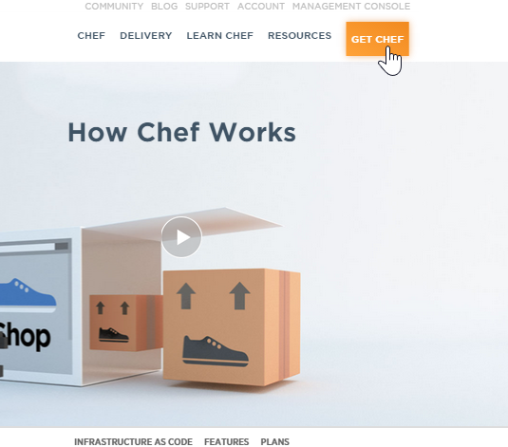
GE: Signing Up for a Hosted Chef Account
Steps
Navigate to https://www.chef.io
From the resulting window, click Get Chef.
Notes:
To get started with Hosted Chef Server, visit the Chef website and sign up for a Hosted Chef Account.

Slide 14
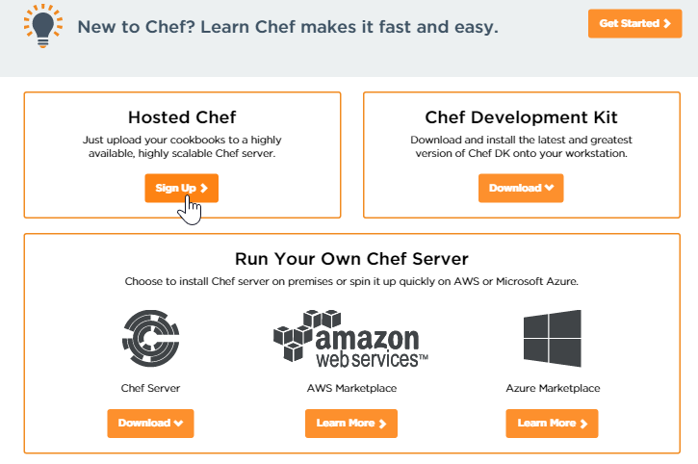
GE: Signing Up for a Hosted Chef Account
Steps
From the resulting window, click the Hosted Chef Sign Up button.

Slide 15
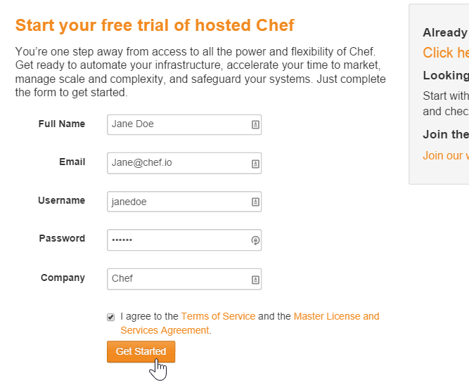
GE: Signing Up for a Hosted Chef Account
Steps
Fill out the form as indicated in this image using your name and a valid email address and then click Get Started.
Note: You should write down your new user name and remember your password.
Notes:
Instructor Note: Learners that already have an account will login instead of creating an account. The learner's account may be tied to an production organization. The learner can create a new organization with their existing account. If there are still concerns they can create a new login with a unique email address.

Slide 16
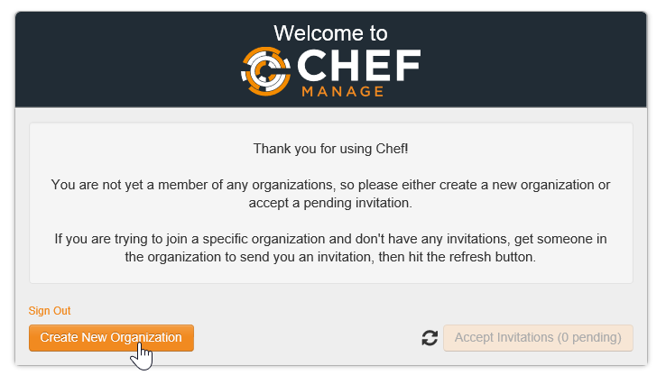
GE: Signing Up for a Hosted Chef Account
Steps
From the resulting page, click the Create New Organization button.
Notes:
Instructor Note: Learners that already have an account will already have an organization. They are welcome to use that organization if it does not have any cookbooks or nodes from previous exercises or from their production systems. It is often easier to have them create a new organization for the purposes of this training. That can be done through the website.

Slide 17
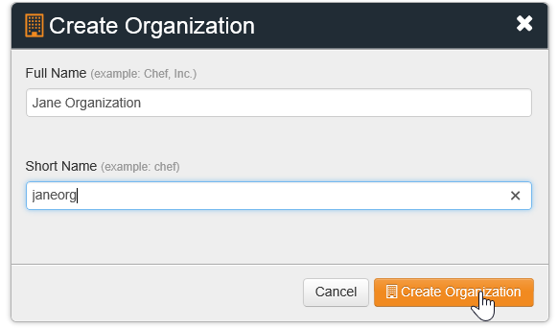
GE: Signing Up for a Hosted Chef Account
Steps
Fill out the resulting Create Organization form and then click Create Organization.
Notes:
An organization is a structure within managed Chef that allows multiple companies or entities to exist on the same Chef Server without your paths ever crossing. You might think of it as like setting up a unique username for your organization.
All of the cookbooks, instances and other configuration details that you manage with Chef will be stored on the Chef Server for this particular organization. No other organization will have access to it.

Slide 18
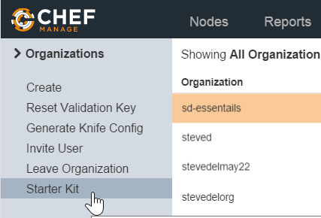

GE: Signing Up for a Hosted Chef Account
Steps
From the resulting page, click your new organization to highlight it and then click Starter Kit.
Notes:
Instructor Note: By far the easiest way to get setup with Managed Chef Server is download the Starter Kit. The most important pieces of the starter kit are found in a hidden directory (".chef") which contains the organization key, user key, and organization configuration file.

Slide 19
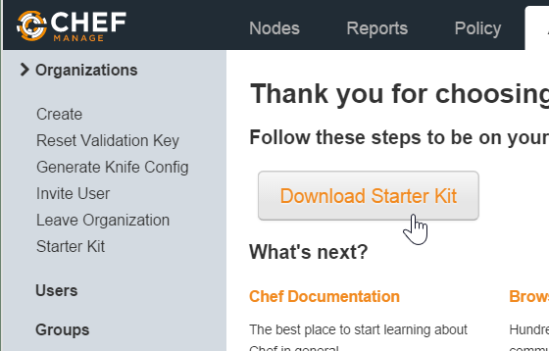
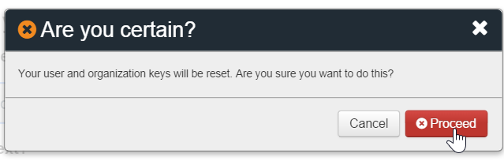
GE: Signing Up for a Hosted Chef Account
Steps
From the resulting window, click the Download Starter Kit button.
Click the Proceed button when prompted.
Notes:
The starter kit will warn that it will reset your organization key and personal key. If this is a new account and new organization this reset is totally fine. If you already have an account or this is an existing organization please understand that you are destroying the existing keys that already exist on a workstation.
Instructor Note: If the learner already has an account and an organization tied to that account this will reset their personal key and organizational key. This means that the other chef repository that they were previously maintaining will no longer be able to communicate with the Chef Server.

Slide 20
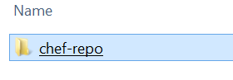
GE: Signing Up for a Hosted Chef Account
Steps
Open the downloaded zip file and copy chef-repo folder that's contained in the zip file.
Paste the chef-repo folder to a location on your laptop, such as your home directory.
Note: Ensure that the path to the chef-repo does not have a space in it. Examples:
Mac: /home/username/chef-repo
Windows: C:\Users\username\chef-repo
Notes:
Instructor Note: The reason that spaces are not suggested is that Ruby tools have a hard time with file paths that contain spaces.

Slide 21
GE: Download a Repository
This process is too messy
A repository containing a similar copy of the work you did previously in this course can be downloaded from here:
https://github.com/chef-training/chefdk-fundamentals-repo
Notes:
The cookbooks that were created during the first modules can be found here. These are not the exact cookbooks that you created but ones that have been completed with additional comments and details added.
Instructor Note: A learner may want to use the exact copy of the cookbooks that they developed. You may need to coordinate with the learners on using git or other methods to retrieve those cookbooks from those remote workstations.

Slide 22
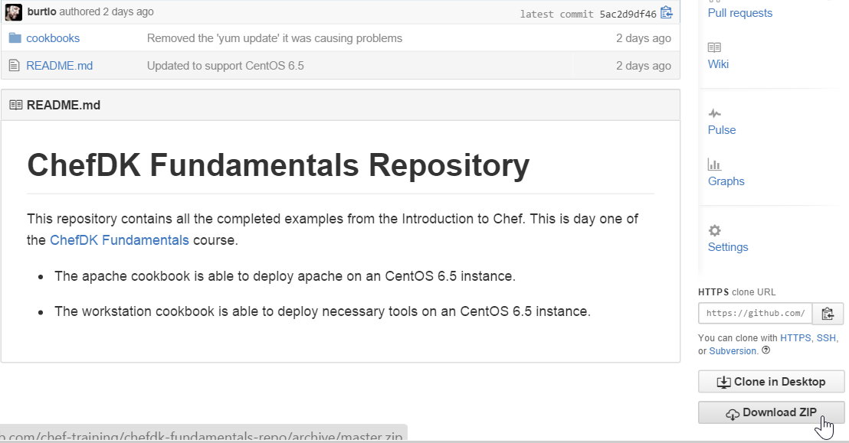
GE: Download the Repository
Notes:
You may clone the repository or download the zip file. Both of those links can be found in the bottom right.

Slide 23
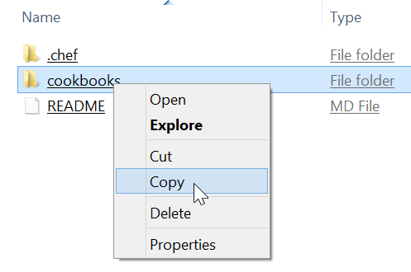

GE: Paste the cookbooks Folder
Steps
Open the downloaded chefdk-fundamentals-repo-master zip file and then copy only the cookbooks folder that's contained in the zip file.
Replace the cookbooks folder that's in your chef-repo folder with the copied cookbooks folder.
chef-repo
Notes:
After you download and open the chefdk-fundamentals-repo archive, copy the included cookbooks folder and paste it into your chef-repo that you unzipped from the Start Kit. Let the new cookbooks folder (that you got from the chefdk-fundamentals-repo) overwrite the existing cookbooks folder that was in your chef-repo folder.
Important: If you had an existing chef-repo prior to class that you want to preserve, save a copy of your old cookbooks folder before pasting the new one into your chef-repo.
Instructor Note: The Starter Kit only contained a starter cookbook that has no value to the learner.
Alternative workflow:-
$ git clone https://github.com/chef-training/chefdk-fundamentals-repo
$ mv chefdk-fundamentals-repo/cookbooks/* chef-repo/cookbooks/

Slide 24
GE: Navigate to the chef-repo
$ cd ~/chef-repo
Notes:
The starter kit contains the configuration to reach the Chef Server and your credentials to validate the communicate between your workstation and the Chef Server.
To verify the connection with the Chef Server you will need to run commands within the repository you downloaded.
Open a terminal or command prompt and navigate to the chef-repo directory.

Slide 25
knife
knife is a command-line tool that provides an interface between a local chef-repo and the Chef Server.
Notes:
knife is a command-line tool that allows us to request and send information to the Chef Server.
knife helps users manage:
Nodes
Cookbooks and recipes
Roles
and more
knife provides a number of sub-commands.

Slide 26
GE: knife --help
$ knife --help
Available subcommands: (for details, knife SUB-COMMAND --help)
** BOOTSTRAP COMMANDS **
knife bootstrap FQDN (options)
knife bootstrap windows ssh FQDN (options)
knife bootstrap windows winrm FQDN (options)
** CLIENT COMMANDS **
knife client bulk delete REGEX (options)
knife client create CLIENT (options)
knife client delete CLIENT (options)
knife client edit CLIENT (options)
Notes:
You can look at all the commands with 'knife –help'.
This will display all the sub-commands available. In your case you want to verify that the client list contains a single entry so you need to look for help for the specific command 'knife client --help'.

Slide 27
GE: knife client --help
$ knife client --help
Available client subcommands: (for details, knife SUB-COMMAND --help)
** CLIENT COMMANDS **
knife client bulk delete REGEX (options)
knife client create CLIENT (options)
knife client delete CLIENT (options)
knife client edit CLIENT (options)
knife client list (options)
knife client reregister CLIENT (options)
knife client show CLIENT (options)
Notes:
This will give us an even smaller subset of the commands related specifically to asking the Chef Server about client information. A general command is the list command which will output all the clients that the Chef Server currently maintains.

Slide 28
GE: knife client list
$ knife client list
ORGNAME-validator
Notes:
For your Chef Server account there should be a single client that is the organization name: validator. This is a special key that has access to the Chef Server. The important thing is that the result does not contain an error with the configuration or authenticating with the Chef Server.
If you receive an error ensure that you:
typed the command correctly
executed the command within the chef repository
are connected to the internet and not blocking ssl connections from your own system's proxy servers or virtual private networks
have a .chef directory, within the chef repository, which contains the knife configuration file (knife.rb), personal key, and organizational key

Slide 29
Hosted Chef
More easily manage multiple nodes
Create a Hosted Chef Account
Upload your cookbooks to the Hosted Chef Server
Add your old workstation as a managed node
Notes:
With all that complete, you are now able to communicate with the Chef Server. At this point we will refer to the system in front of you, with the chef repository, the configuration, and the keys installed as your workstation.
When working with Chef with a Chef Server, the workstation is the location where you will compose your cookbook code. When that code is complete, you will then upload it to the Chef Server.

Slide 30
GE: knife cookbook --help
$ knife cookbook --help
** COOKBOOK COMMANDS **
knife cookbook bulk delete REGEX (options)
knife cookbook create COOKBOOK (options)
knife cookbook delete COOKBOOK VERSION (options)
knife cookbook download COOKBOOK [VERSION] (options)
knife cookbook list (options)
knife cookbook metadata COOKBOOK (options)
knife cookbook metadata from FILE (options)
knife cookbook show COOKBOOK [VERSION] [PART] [FILENAME] (options)
knife cookbook test [COOKBOOKS...] (options)
knife cookbook upload [COOKBOOKS...] (options)
Notes:
Similar to asking the Chef Server about the list of available clients, you can also ask for information about cookbooks. You can find all the commands related to the cookbooks subcommand by running `knife cookbook --help`.
Similar to the list of clients, you can examine a list of cookbooks.

Slide 31
GE: knife cookbook list
$ knife cookbook list
Notes:
Running this command will return the cookbooks currently uploaded to the Chef Server. The empty response should come as no surprise.
You want to change that. So you are going to upload each of your cookbooks to the Chef Server.

Slide 32
GE: Change to the cookbooks/apache Directory
$ cd cookbooks/apache
Notes:
To upload a cookbook to the Chef Server you need to be within the directory of the cookbook. Let us start with the apache cookbook. Change directory into the apache cookbook directory which is within the cookbooks directory.

Slide 33
Berkshelf
Berkshelf is a cookbook management tool that allows us to upload your cookbooks and all of its dependencies to the Chef Server.
berkshelf.com
Notes:
To upload the cookbook you will need to use another tool called Berkshelf.
Berkshelf is a cookbook management tool that allows us to upload your cookbooks and all of its dependencies to the Chef Server. In this instance, your current cookbooks have no dependencies, but in the future when they do, Berkshelf will assist you in ensuring those are all uploaded.

Slide 34
GE: Run berks --help
$ berks --help
Commands:
berks apply ENVIRONMENT # Apply version locks from Berksfile.lock to a Chef environment
berks contingent COOKBOOK # List all cookbooks that depend on the given cookbook in your
berks cookbook NAME [PATH] # Create a skeleton for a new cookbook
berks help [COMMAND] # Describe available commands or one specific command
berks info [COOKBOOK] # Display name, author, copyright, and dependency information
berks init [PATH] # Initialize Berkshelf in the given directory
berks install # Install the cookbooks specified in the Berksfile
berks list # List cookbooks and their dependencies specified by your
berks outdated [COOKBOOKS] # List dependencies that have new versions available that
berks package [PATH] # Vendor and archive the dependencies of a Berksfile
berks search NAME # Search the remote source for cookbooks matching the partial
Notes:
Berkshelf is a command-line tool that you can ask to see available the commands.

Slide 35
GE: Run berks install
$ berks install
Resolving cookbook dependencies...
Fetching 'apache' from source at .
Fetching cookbook index from https://supermarket.chef.io...
Using apache (0.2.1) from source at .
Notes:
Berkshelf is used on a per-cookbook basis. As dependencies are often per cookbook you'll need to change into the directory of the cookbook.
You should install any dependencies that your cookbook might have. Again, in this instance there are no dependencies external to this cookbook but Berkshelf ensures that this is the case when it runs the 'berks install' command.
You'll see that it finds the current cookbook within your current directory, it contacts the Supermarket for any external dependencies, and then ...

Slide 36
GE: See the Berksfile.lock
$ ls -al (or ls -Force if using Powershell)
drwxr-xr-x 7 chef chef 4096 Aug 27 18:44 .
drwxr-xr-x 4 chef chef 4096 Aug 27 16:17 ..
drwxr-xr-x 8 chef chef 4096 Aug 27 16:07 .git
-rw-r--r-- 1 chef chef 126 Aug 27 15:46 .gitignore
drwxr-xr-x 3 chef chef 4096 Aug 27 18:45 .kitchen
-rw-r--r-- 1 chef chef 183 Aug 27 18:44 .kitchen.yml
-rw-r--r-- 1 chef chef 47 Aug 27 15:46 Berksfile
-rw------- 1 chef chef 77 Aug 27 18:45 Berksfile.lock
-rw-r--r-- 1 chef chef 54 Aug 27 15:46 README.md
-rw-r--r-- 1 chef chef 974 Aug 27 15:46 chefignore
-rw-r--r-- 1 chef chef 198 Aug 27 15:46 metadata.rb
drwxr-xr-x 2 chef chef 4096 Aug 27 16:34 recipes
Notes:
...it completes by writing a Berksfile.lock to the file system.
The Berksfile.lock is a receipt of all the cookbooks and dependencies found at the exact moment that you ran 'berks install'.

Slide 37
GE: See the Contents of the Berksfile.lock
$ cat Berksfile.lock
DEPENDENCIES
apache
path: .
metadata: true
GRAPH
apache (0.2.1)
Notes:
This lock file is useful to ensure that in the future you use the same dependencies when working with the cookbook.

Slide 38
GE: Upload the Cookbook to the Chef Server
$ berks upload
Uploaded apache (0.2.1) to: 'https://api.opscode.com:443/organizations/steveessentials2'
Notes:
With the dependencies accounted for, it is time to upload the to the Chef Server. This is another sub-command that Berkshelf provides called 'upload'. Run the command to upload the apache cookbook to the Chef Server.

Slide 39
GE: Display Cookbooks within Your Org
$ knife cookbook list
apache 0.2.1
Notes:
When that is complete you can return to the cookbook command that allows you to display the cookbooks within your organization by running this command. This will show you that the Chef Server has the apache cookbook that you have uploaded.

Slide 40
Lab: Upload Cookbooks
Upload your remaining cookbooks
Verify that all cookbooks are uploaded
Notes:
As an lab upload the remaining cookbooks within the cookbooks directory. After you have done that verify that the cookbooks have been uploaded.
Instructor Note: Allow 5 minutes to complete this exercise.

Slide 41
Lab: cd and Run knife cookbook list
$ cd ~/chef-repo/cookbooks/workstation
$ knife cookbook list
apache 0.2.1
Notes:
The one remaining cookbook is the workstation cookbook. Berkshelf is a cookbook management tool that examines the contents and dependencies of a single cookbook.
Change into the cookbooks directory.
Verify that the cookbook is not currently uploaded.

Slide 42
Lab: Install the Cookbook Dependencies
$ berks install
Resolving cookbook dependencies...
Fetching 'workstation' from source at .
Fetching cookbook index from https://supermarket.chef.io...
Using workstation (0.2.1) from source at .
Notes:
Run "berks install" to install all the cookbook dependencies.

Slide 43
Lab: Upload the Cookbook to the Chef Server
$ berks upload
Uploaded workstation (0.2.1) to: 'https://api.opscode.com:443/organizations/steveessentials2'
Notes:
Run "berks upload" to upload the cookbook and all its dependencies to the Chef Server.

Slide 44
Lab: Is the workstation Cookbook Uploaded?
$ knife cookbook list
apache 0.2.1
workstation 0.2.1
Notes:
Lastly, run "knife cookbook list" to validate that the workstation cookbook is now uploaded to the Chef Server.

Slide 45
Hosted Chef
More easily manage multiple nodes
Create a Hosted Chef Account
Upload your cookbooks to the Hosted Chef Server
Add your old workstation as a managed node
Notes:
You have one remaining objective and that is to add an instance as a node within your organization.

Slide 46
The Node
Organization 1 Nodes
Organization 2 Nodes
Organization 3 Nodes
Chef Server
Notes:
As you know by now, a node is a server that Chef is managing. A node could be a web server, an application server, a database server, a proxy server, and so on.
A node can only join one organization. To be a node means that it has Chef installed, has configuration files in place, and when you run the chef-client application with no parameters it will successfully contact the Chef Server and ask it for the run list that it should apply and the cookbooks required to execute that run list.
When a node is part of the organization you manage that information on the Chef Server as well. A Chef Server can manage multiple organizations. Managing that information in a Chef Server allows us to use for inventory, querying and searching.

Slide 47
GE: Change to the chef-repo
$ cd ~/chef-repo
Notes:
Let's add the instance we used previously as a workstation now as a managed node. Return to the root of the chef repository.

Slide 48
GE: Run 'knife node –help'
$ knife node --help
** NODE COMMANDS **
knife node bulk delete REGEX (options)
knife node create NODE (options)
knife node delete NODE (options)
knife node edit NODE (options)
knife node environment set NODE ENVIRONMENT
knife node from file FILE (options)
knife node list (options)
knife node run_list add [NODE] [ENTRY[,ENTRY]] (options)
knife node run_list remove [NODE] [ENTRY[,ENTRY]] (options)
knife node run_list set NODE ENTRIES (options)
knife node show NODE (options)
Notes:
Verify that you have no existing nodes within your organization. You can use the 'knife node –help' command to see that you can ask for the list of all nodes within your organization with the list command.

Slide 49
GE: Run 'knife node list'
$ knife node list
Notes:
Run "knife node list" to see that you have no nodes currently registered with your Chef Server. At this point the results should be blank.

Slide 50
GE: Run 'knife bootstrap –help'
$ knife bootstrap --help
knife bootstrap FQDN (options)
--bootstrap-curl-options OPTIONS
Add options to curl when install chef-client
--bootstrap-install-command COMMANDS
Custom command to install chef-client
--bootstrap-no-proxy [NO_PROXY_URL|NO_PROXY_IP]
Do not proxy locations for the node being bootstrapped; this option is used internally by Opscode
--bootstrap-proxy PROXY_URL The proxy server for the node being bootstrapped
-t TEMPLATE, Bootstrap Chef using a built-in or custom template. Set to the full path of an erb template or use one of the built-in templates.
Notes:
Knife provides a bootstrap subcommand that takes a number of options.
When you bootstrap an instance it is performing the following:
* Installing chef tools if they are not already installed
* Configuring Chef to communicate with the Chef Server
* Running chef-client to apply a default run list

Slide 51
GE: Bootstrap Your Node
$ knife bootstrap FQDN -x USER -P PWD --sudo -N node1
Creating new client for node1
Creating new node for node1
Connecting to ec2-54-175-46-24.compute-1.amazonaws.com
ec2-54-175-46-24.compute-1.amazonaws.com Starting first Chef Client run...
ec2-54-175-46-24.compute-1.amazonaws.com Starting Chef Client, version 12.3.0
ec2-54-175-46-24.compute-1.amazonaws.com resolving cookbooks for run list: []
ec2-54-175-46-24.compute-1.amazonaws.com Synchronizing Cookbooks:
ec2-54-175-46-24.compute-1.amazonaws.com Compiling Cookbooks...
ec2-54-175-46-24.compute-1.amazonaws.com [2015-09-16T16:51:21+00:00] WARN: Node node1 has an empty run list.
ec2-54-175-46-24.compute-1.amazonaws.com Converging 0 resources
ec2-54-175-46-24.compute-1.amazonaws.com
ec2-54-175-46-24.compute-1.amazonaws.com Running handlers:
Notes:
To communicate with the remote instance you need to provide it the credentials to connect to the system. Use the user name with the '-x' flag and the password '-P' flag.
Include the '--sudo' flag because you are installing software and writing configuration to directories traditionally owned by the root user.
Name the node with the '-N' flag. This is optional but makes it easier for us to communicate. When we ask you to look at the details of node 1 or login to node 1, it will be easier to remember than the fully-qualified domain name.
When executing the command, the output will tell us what it installed and ran.
<<WIP rename 'node1' to 'web01' throughout?

Slide 52
GE: Run 'knife node list' Again
$ knife node list
node1
Notes:
When bootstrapping is done, you can see that your organization knows about the new node by again running the command "knife node list". You now see that you have a new node, node1, uploaded to the Chef Server.
<<WIP rename 'node1' to 'web01' throughout?

Slide 53
GE: View More Information About Your Node
$ knife node show node1
Node Name: node1
Environment: _default
FQDN: ip-172-31-8-68.ec2.internal
IP: 54.175.46.24
Run List:
Roles:
Recipes:
Platform: centos 6.7
Tags:
Notes:
You can see more information about a particular node with the command 'knife node show node1'. This will display a summary of the node information that the Chef Server stores.
<<WIP rename 'node1' to 'web01' throughout?

Slide 54
What happened during bootstrap?
Chef and all of its dependencies installed
Installation includes
The Ruby language - used by Chef
chef-client - Client application
ohai - System profiler
...and more
Notes:
A quick mention that we just used the omnibus installer which puts Chef and all of its dependencies on the workstation. The tools are installed under /opt/chef (linux/mac) or C:\Chef (Windows).
Also mention that ‘gem install chef’ is also a valid installation method if students are already using rvm, rbevn, or chruby to manage their Ruby installations or if they’d prefer to use the system ruby (which should be at version 1.9 or better to use this method).
Opscode manages an open source project called "Omnibus". Use omnibus to create OS-specific packages.

Slide 55
knife bootstrap sequence
Chef Server
Workstation
Node

Slide 56
knife bootstrap sequence
knife bootstrap <IP> --sudo -x chef -P chef -N "mynode"
Chef Server
Workstation
Node

Slide 57

knife bootstrap sequence
knife bootstrap <IP> --sudo -x chef -P chef -N "mynode"
Chef Server
Workstation
chef_server_url
validation_client_name
validation_client_key
ssh / scp
Node

Slide 58

knife bootstrap sequence
knife bootstrap <IP> --sudo -x chef -P chef -N "mynode"
Chef Server
Workstation
ssh / scp
install chef-client
configure chef-client
run chef-client
Node

Slide 59

knife bootstrap sequence
knife bootstrap <IP> --sudo -x chef -P chef -N "mynode"
Chef Server
Workstation
register node
save node details
Node

Slide 60

knife bootstrap sequence
knife bootstrap <IP> --sudo -x chef -P chef -N "mynode"
Chef Server
Workstation
register node
save node details
Node

Slide 61

knife bootstrap sequence
knife bootstrap <IP> --sudo -x chef -P chef -N "mynode"
Chef Server
Workstation
register node
save node details
Node
Notes:
<<WIP Cover new 12.# bootstrap functionality where you can bootstrap, but not converge.

Slide 62
GE: Add a Recipe to a Run List
$ knife node run_list add node1 "recipe[apache]"
node1:
run_list: recipe[apache]
Notes:
node1 does not have a list of recipes that it applies to the system by default. You can make Chef Server tell node1 to apply a specific run-list the next time node 1 runs 'chef-client'.
You can do that through the 'knife node run_list add' command. In this example, you are adding to node1's run-list the apache cookbook's default recipe.
<<WIP rename 'node1' to 'web01' throughout?

Slide 63
GE: Rerun chef-client on the node
node1$ sudo chef-client
...
@@ -1 +1,8 @@
+<html>
+ <body>
+ <h1>Hello, world!</h1>
+ <h2>ipaddress: 172.31.29.218</h2>
+ <h2>hostname: ip-172-31-29-218</h2>
+</body>
+</html>
* service[httpd] action enable
- enable service service[httpd]
* service[httpd] action start
- start service service[httpd]
Running handlers:
Running handlers complete
Chef Client finished, 4/4 resources updated in 25.003999599 seconds
Notes:
Need to log in as chef/chef

Slide 64
GE: Testing our webserver
Notes:
Point a web browser to the URL or public IP address of your proxy server. It should display the web page of the web server node that the proxy server is configured to serve.

Slide 65
What happened during subsequent chef-client runs?
Notes:
A quick mention that we just used the omnibus installer which puts Chef and all of its dependencies on the workstation. The tools are installed under /opt/chef (linux/mac) or C:\Chef (Windows).
Also mention that ‘gem install chef’ is also a valid installation method if students are already using rvm, rbevn, or chruby to manage their Ruby installations or if they’d prefer to use the system ruby (which should be at version 1.9 or better to use this method).
Opscode manages an open source project called "Omnibus". Use omnibus to create OS-specific packages.

Slide 66

chef-client
Notes:
1. Chef client starts up.
2. Chef builds the node object, where it runs ohai to find out the node_name (fqdn) and the node's platform/platform_version
3. Chef authenticates with the server as the node_name, using the API client key. We'll cover the authentication cycle in detail shortly.
4. All the cookbooks required for the node's expanded run list are synchronized to the node.
5. All the cookbooks Ruby components are loaded, recipes are included as well.
6. Node is converged, which is when it configures the resources contained in the recipes.
7. Was the convergence successful? If so, the node is saved.
8. If not the run ends with an exception and a message is printed about the error, and the stack trace file path is included in this.
9. Any notification handlers are run, which can do different things depending on whether the run was successful or not, such as send email or connect to an external service like IRC or Campfire.

Slide 67


chef-client
build node
Notes:
1. Chef client starts up.
2. Chef builds the node object, where it runs ohai to find out the node_name (fqdn) and the node's platform/platform_version
3. Chef authenticates with the server as the node_name, using the API client key. We'll cover the authentication cycle in detail shortly.
4. All the cookbooks required for the node's expanded run list are synchronized to the node.
5. All the cookbooks Ruby components are loaded, recipes are included as well.
6. Node is converged, which is when it configures the resources contained in the recipes.
7. Was the convergence successful? If so, the node is saved.
8. If not the run ends with an exception and a message is printed about the error, and the stack trace file path is included in this.
9. Any notification handlers are run, which can do different things depending on whether the run was successful or not, such as send email or connect to an external service like IRC or Campfire.

Slide 68

chef-client
build node
Ohai!
node_name
platform
platform_version
Notes:
1. Chef client starts up.
2. Chef builds the node object, where it runs ohai to find out the node_name (fqdn) and the node's platform/platform_version
3. Chef authenticates with the server as the node_name, using the API client key. We'll cover the authentication cycle in detail shortly.
4. All the cookbooks required for the node's expanded run list are synchronized to the node.
5. All the cookbooks Ruby components are loaded, recipes are included as well.
6. Node is converged, which is when it configures the resources contained in the recipes.
7. Was the convergence successful? If so, the node is saved.
8. If not the run ends with an exception and a message is printed about the error, and the stack trace file path is included in this.
9. Any notification handlers are run, which can do different things depending on whether the run was successful or not, such as send email or connect to an external service like IRC or Campfire.

Slide 69
chef-client
build node
authenticate
Notes:
1. Chef client starts up.
2. Chef builds the node object, where it runs ohai to find out the node_name (fqdn) and the node's platform/platform_version
3. Chef authenticates with the server as the node_name, using the API client key. We'll cover the authentication cycle in detail shortly.
4. All the cookbooks required for the node's expanded run list are synchronized to the node.
5. All the cookbooks Ruby components are loaded, recipes are included as well.
6. Node is converged, which is when it configures the resources contained in the recipes.
7. Was the convergence successful? If so, the node is saved.
8. If not the run ends with an exception and a message is printed about the error, and the stack trace file path is included in this.
9. Any notification handlers are run, which can do different things depending on whether the run was successful or not, such as send email or connect to an external service like IRC or Campfire.

Slide 70



chef-client
build node
authenticate
sync cookbooks
expanded run list
(recipes)
Notes:
1. Chef client starts up.
2. Chef builds the node object, where it runs ohai to find out the node_name (fqdn) and the node's platform/platform_version
3. Chef authenticates with the server as the node_name, using the API client key. We'll cover the authentication cycle in detail shortly.
4. All the cookbooks required for the node's expanded run list are synchronized to the node.
5. All the cookbooks Ruby components are loaded, recipes are included as well.
6. Node is converged, which is when it configures the resources contained in the recipes.
7. Was the convergence successful? If so, the node is saved.
8. If not the run ends with an exception and a message is printed about the error, and the stack trace file path is included in this.
9. Any notification handlers are run, which can do different things depending on whether the run was successful or not, such as send email or connect to an external service like IRC or Campfire.

Slide 71


chef-client
build node
authenticate
load cookbooks
sync cookbooks
Notes:
1. Chef client starts up.
2. Chef builds the node object, where it runs ohai to find out the node_name (fqdn) and the node's platform/platform_version
3. Chef authenticates with the server as the node_name, using the API client key. We'll cover the authentication cycle in detail shortly.
4. All the cookbooks required for the node's expanded run list are synchronized to the node.
5. All the cookbooks Ruby components are loaded, recipes are included as well.
6. Node is converged, which is when it configures the resources contained in the recipes.
7. Was the convergence successful? If so, the node is saved.
8. If not the run ends with an exception and a message is printed about the error, and the stack trace file path is included in this.
9. Any notification handlers are run, which can do different things depending on whether the run was successful or not, such as send email or connect to an external service like IRC or Campfire.

Slide 72
chef-client
build node
authenticate
converge
load cookbooks
sync cookbooks
Notes:
1. Chef client starts up.
2. Chef builds the node object, where it runs ohai to find out the node_name (fqdn) and the node's platform/platform_version
3. Chef authenticates with the server as the node_name, using the API client key. We'll cover the authentication cycle in detail shortly.
4. All the cookbooks required for the node's expanded run list are synchronized to the node.
5. All the cookbooks Ruby components are loaded, recipes are included as well.
6. Node is converged, which is when it configures the resources contained in the recipes.
7. Was the convergence successful? If so, the node is saved.
8. If not the run ends with an exception and a message is printed about the error, and the stack trace file path is included in this.
9. Any notification handlers are run, which can do different things depending on whether the run was successful or not, such as send email or connect to an external service like IRC or Campfire.

Slide 73

chef-client
build node
authenticate
converge
load cookbooks
sync cookbooks
success?
Notes:
1. Chef client starts up.
2. Chef builds the node object, where it runs ohai to find out the node_name (fqdn) and the node's platform/platform_version
3. Chef authenticates with the server as the node_name, using the API client key. We'll cover the authentication cycle in detail shortly.
4. All the cookbooks required for the node's expanded run list are synchronized to the node.
5. All the cookbooks Ruby components are loaded, recipes are included as well.
6. Node is converged, which is when it configures the resources contained in the recipes.
7. Was the convergence successful? If so, the node is saved.
8. If not the run ends with an exception and a message is printed about the error, and the stack trace file path is included in this.
9. Any notification handlers are run, which can do different things depending on whether the run was successful or not, such as send email or connect to an external service like IRC or Campfire.

Slide 74

chef-client
build node
authenticate
converge
load cookbooks
sync cookbooks
node.save
success?
Yes
Notes:
1. Chef client starts up.
2. Chef builds the node object, where it runs ohai to find out the node_name (fqdn) and the node's platform/platform_version
3. Chef authenticates with the server as the node_name, using the API client key. We'll cover the authentication cycle in detail shortly.
4. All the cookbooks required for the node's expanded run list are synchronized to the node.
5. All the cookbooks Ruby components are loaded, recipes are included as well.
6. Node is converged, which is when it configures the resources contained in the recipes.
7. Was the convergence successful? If so, the node is saved.
8. If not the run ends with an exception and a message is printed about the error, and the stack trace file path is included in this.
9. Any notification handlers are run, which can do different things depending on whether the run was successful or not, such as send email or connect to an external service like IRC or Campfire.

Slide 75

chef-client
build node
authenticate
converge
load cookbooks
sync cookbooks
node.save
success?
Yes
exception
No
Notes:
1. Chef client starts up.
2. Chef builds the node object, where it runs ohai to find out the node_name (fqdn) and the node's platform/platform_version
3. Chef authenticates with the server as the node_name, using the API client key. We'll cover the authentication cycle in detail shortly.
4. All the cookbooks required for the node's expanded run list are synchronized to the node.
5. All the cookbooks Ruby components are loaded, recipes are included as well.
6. Node is converged, which is when it configures the resources contained in the recipes.
7. Was the convergence successful? If so, the node is saved.
8. If not the run ends with an exception and a message is printed about the error, and the stack trace file path is included in this.
9. Any notification handlers are run, which can do different things depending on whether the run was successful or not, such as send email or connect to an external service like IRC or Campfire.

Slide 76

chef-client
build node
authenticate
converge
load cookbooks
sync cookbooks
node.save
success?
notification
handlers
Yes
exception
No
Notes:
1. Chef client starts up.
2. Chef builds the node object, where it runs ohai to find out the node_name (fqdn) and the node's platform/platform_version
3. Chef authenticates with the server as the node_name, using the API client key. We'll cover the authentication cycle in detail shortly.
4. All the cookbooks required for the node's expanded run list are synchronized to the node.
5. All the cookbooks Ruby components are loaded, recipes are included as well.
6. Node is converged, which is when it configures the resources contained in the recipes.
7. Was the convergence successful? If so, the node is saved.
8. If not the run ends with an exception and a message is printed about the error, and the stack trace file path is included in this.
9. Any notification handlers are run, which can do different things depending on whether the run was successful or not, such as send email or connect to an external service like IRC or Campfire.

Slide 77
How does Authentication Work?
Notes:
A quick mention that we just used the omnibus installer which puts Chef and all of its dependencies on the workstation. The tools are installed under /opt/chef (linux/mac) or C:\Chef (Windows).
Also mention that ‘gem install chef’ is also a valid installation method if students are already using rvm, rbevn, or chruby to manage their Ruby installations or if they’d prefer to use the system ruby (which should be at version 1.9 or better to use this method).
Opscode manages an open source project called "Omnibus". Use omnibus to create OS-specific packages.

Slide 78
Private Keys
Chef Server requires client.pem private key to authenticate
This is generated on first contact with Chef Server using
validation.pem - private key for ORGNAME-validator (if it exists)
user.pem - private key for the user instigating the bootstrap if validation.pem doesn't exist
Let's see how those are used (in our case with validation.pem from starter kit)...
Notes:
You can "cat" these if you want :).
There are two .pem private key files on the system. The client.pem was created during the authentication cycle we just discussed. It is the private key for *this* node. The public key is stored on the Chef server.
The validation.pem is the private key for the validation client, also called the organization key. The validation.pem file can be deleted.

Slide 79

/etc/chef/client.pem?
Notes:
Take a minute to talk about how chef does authentication:
* We digitally sign each request with a private key
* We verify that signature
* We protect against replay attacks as well
* There is no central store for Private Keys - meaning you have to keep them safe. It also means no attacker can compromise your security credentials centrally.
Lets take a detailed look at the authentication cycle. When Chef client starts, it first looks for /etc/chef/client.pem.
1. If the client.pem exists, chef will use it to sign requests with the chef server API.
2. If the client.pem does not exist, chef looks for /etc/chef/validation.pem, the validation_key.
3. If the validation key does not exist, then chef exits, or if the key does not match for the validation API client, chef reports a 401 and exits.
4. If the validation key exists, and it matches for the validation API client, chef requests a new API client for this node_name and writes this to /etc/chef/client.pem
5. Chef will use the newly created client to sign requests with the chef server API for all further requests.
If key lost: must delete node & regenerate

Slide 80


/etc/chef/client.pem?
Yes
Sign Requests
Notes:
Take a minute to talk about how chef does authentication:
* We digitally sign each request with a private key
* We verify that signature
* We protect against replay attacks as well
* There is no central store for Private Keys - meaning you have to keep them safe. It also means no attacker can compromise your security credentials centrally.
Lets take a detailed look at the authentication cycle. When Chef client starts, it first looks for /etc/chef/client.pem.
1. If the client.pem exists, chef will use it to sign requests with the chef server API.
2. If the client.pem does not exist, chef looks for /etc/chef/validation.pem, the validation_key.
3. If the validation key does not exist, then chef exits, or if the key does not match for the validation API client, chef reports a 401 and exits.
4. If the validation key exists, and it matches for the validation API client, chef requests a new API client for this node_name and writes this to /etc/chef/client.pem
5. Chef will use the newly created client to sign requests with the chef server API for all further requests.
If key lost: must delete node & regenerate

Slide 81
/etc/chef/client.pem?
/etc/chef/validation.pem?
No
Yes
Sign Requests
Notes:
Take a minute to talk about how chef does authentication:
* We digitally sign each request with a private key
* We verify that signature
* We protect against replay attacks as well
* There is no central store for Private Keys - meaning you have to keep them safe. It also means no attacker can compromise your security credentials centrally.
Lets take a detailed look at the authentication cycle. When Chef client starts, it first looks for /etc/chef/client.pem.
1. If the client.pem exists, chef will use it to sign requests with the chef server API.
2. If the client.pem does not exist, chef looks for /etc/chef/validation.pem, the validation_key.
3. If the validation key does not exist, then chef exits, or if the key does not match for the validation API client, chef reports a 401 and exits.
4. If the validation key exists, and it matches for the validation API client, chef requests a new API client for this node_name and writes this to /etc/chef/client.pem
5. Chef will use the newly created client to sign requests with the chef server API for all further requests.
If key lost: must delete node & regenerate

Slide 82
/etc/chef/client.pem?
/etc/chef/validation.pem?
No
No
401!
Yes
Sign Requests
Notes:
Take a minute to talk about how chef does authentication:
* We digitally sign each request with a private key
* We verify that signature
* We protect against replay attacks as well
* There is no central store for Private Keys - meaning you have to keep them safe. It also means no attacker can compromise your security credentials centrally.
Lets take a detailed look at the authentication cycle. When Chef client starts, it first looks for /etc/chef/client.pem.
1. If the client.pem exists, chef will use it to sign requests with the chef server API.
2. If the client.pem does not exist, chef looks for /etc/chef/validation.pem, the validation_key.
3. If the validation key does not exist, then chef exits, or if the key does not match for the validation API client, chef reports a 401 and exits.
4. If the validation key exists, and it matches for the validation API client, chef requests a new API client for this node_name and writes this to /etc/chef/client.pem
5. Chef will use the newly created client to sign requests with the chef server API for all further requests.
If key lost: must delete node & regenerate

Slide 83

/etc/chef/client.pem?
/etc/chef/validation.pem?
No
No
401!
Yes
Request API Client
Yes
Sign Requests
Notes:
Take a minute to talk about how chef does authentication:
* We digitally sign each request with a private key
* We verify that signature
* We protect against replay attacks as well
* There is no central store for Private Keys - meaning you have to keep them safe. It also means no attacker can compromise your security credentials centrally.
Lets take a detailed look at the authentication cycle. When Chef client starts, it first looks for /etc/chef/client.pem.
1. If the client.pem exists, chef will use it to sign requests with the chef server API.
2. If the client.pem does not exist, chef looks for /etc/chef/validation.pem, the validation_key.
3. If the validation key does not exist, then chef exits, or if the key does not match for the validation API client, chef reports a 401 and exits.
4. If the validation key exists, and it matches for the validation API client, chef requests a new API client for this node_name and writes this to /etc/chef/client.pem
5. Chef will use the newly created client to sign requests with the chef server API for all further requests.
If key lost: must delete node & regenerate

Slide 84

/etc/chef/client.pem?
/etc/chef/validation.pem?
No
No
401!
Yes
Request API Client
Yes
Sign Requests
client.pem
Notes:
Take a minute to talk about how chef does authentication:
* We digitally sign each request with a private key
* We verify that signature
* We protect against replay attacks as well
* There is no central store for Private Keys - meaning you have to keep them safe. It also means no attacker can compromise your security credentials centrally.
Lets take a detailed look at the authentication cycle. When Chef client starts, it first looks for /etc/chef/client.pem.
1. If the client.pem exists, chef will use it to sign requests with the chef server API.
2. If the client.pem does not exist, chef looks for /etc/chef/validation.pem, the validation_key.
3. If the validation key does not exist, then chef exits, or if the key does not match for the validation API client, chef reports a 401 and exits.
4. If the validation key exists, and it matches for the validation API client, chef requests a new API client for this node_name and writes this to /etc/chef/client.pem
5. Chef will use the newly created client to sign requests with the chef server API for all further requests.
If key lost: must delete node & regenerate

Slide 85

/etc/chef/client.pem?
/etc/chef/validation.pem?
No
No
401!
Yes
Request API Client
Yes
Sign Requests
client.pem
Notes:
Take a minute to talk about how chef does authentication:
* We digitally sign each request with a private key
* We verify that signature
* We protect against replay attacks as well
* There is no central store for Private Keys - meaning you have to keep them safe. It also means no attacker can compromise your security credentials centrally.
Lets take a detailed look at the authentication cycle. When Chef client starts, it first looks for /etc/chef/client.pem.
1. If the client.pem exists, chef will use it to sign requests with the chef server API.
2. If the client.pem does not exist, chef looks for /etc/chef/validation.pem, the validation_key.
3. If the validation key does not exist, then chef exits, or if the key does not match for the validation API client, chef reports a 401 and exits.
4. If the validation key exists, and it matches for the validation API client, chef requests a new API client for this node_name and writes this to /etc/chef/client.pem
5. Chef will use the newly created client to sign requests with the chef server API for all further requests.
If key lost: must delete node & regenerate

Slide 86
Hosted Chef
More easily manage multiple nodes
Create a Hosted Chef Account
Upload your cookbooks to the Hosted Chef Server
Add your old workstation as a managed node

Slide 87
Discussion
What is the benefit of storing cookbooks in a central repository?
What is the primary tool for communicating with the Chef Server?
How did you add a node to your organization?
Notes:
Answer these questions.
With your answers, turn to another person and alternate asking each other asking these questions and sharing your answers.

Slide 88
Q&A
What questions can you help you answer?
Chef Server
Managed Chef
Berkshelf
Bootstrapping Nodes
Notes:
With all of the objectives complete you are finished with this section. What question can you answer for you?

